Slide 2


Oracle Application Express 4.2 New Features
Notes:
Add Speaker Name and Title

Slide 3
The following is intended to outline Oracle’s general product direction. It is intended for information purposes only, and may not be incorporated into any contract. It is not a commitment to deliver any material, code, or functionality, and should not be relied upon in making purchasing decisions. The development, release, and timing of any features or functionality described for Oracle’s products remains at the sole discretion of Oracle.
Notes:
3
3
Standard Oracle Safe Harbor slide

Slide 4

Agenda
Oracle Application Express Overview
New Features in 4.2
Beyond Oracle APEX 4.2…
Q&A
Skip Overview

Slide 5
Oracle Application Express
Oracle’s primary tool for developing Web-based applications using SQL and PL/SQL
Database-centric development tool for personal, Intranet, and Internet applications
Develop Desktop and Mobile applications
100% Browser-based Development and Runtime
Declarative framework for rapid application definition, maintenance, and enhancements.
Application scalability inherited from the Oracle Database
Notes:
You do not need any client software – simply a web browser and URL to access development environment and to run applications

Slide 6
Oracle Application Express – History
Also known as Oracle APEX (āʹpěks)
HTML DB 1.5
First Release
HTML DB 1.6
Themes
Application Express 2.1
Oracle XE
Application Express 2.2
Packaged Applications
Application Express 3.1
Interactive Reports
Application Express 4.0
Websheets
Dynamic Actions
Plug-Ins
Team Development
Application Express 4.2
Mobile
HTML5
Packaged Apps
2004
2005
2006
2007
2008
2009
2010
2011
2012
HTML DB 2.0
SQL Workshop
Application Express 3.0
Flash Charts
PDF Printing
Access Migration
Application Express 3.2
Oracle Forms to APEX Conversion
Application Express 4.1
Data Upload
Error Handling
ROWID
Notes:
Generally release a new version of APEX annually
* Next release will be APEX 5.0 – See Statement of Direction for more details
[http://www.oracle.com/technetwork/developer-tools/apex/application-express/apex-sod-087560.html]

Slide 7

Oracle Application Express – No Cost Feature
Fully supported no-cost feature of the Oracle Database
No additional Oracle Database licensing
Any number of developers
Any number of applications
Any number of end-users for those applications
Supported Database Releases
10gR2 (10.2.0.4 +), 11gR1, 11gR2,12c
Exadata, ODA, RAC
Distributed with all Database Editions
Oracle Enterprise Edition; Oracle Standard Edition; Oracle Standard Edition One; and Oracle Express Edition (Oracle XE)
Notes:
Fully supported via Oracle Database support agreement, with dedicated support team within Oracle Support
“No-Cost” Feature means you can build any number of applications and any number of users without additional licensing costs
Requires DB 10.2.0.4 and above
Part of standard database install since 11gR1
Runs in all database editions
NOTE: As APEX is released more frequently than the database you should always update to the latest version of APEX available on OTN
[http://www.oracle.com/technetwork/developer-tools/apex/downloads/index.html]

Slide 8
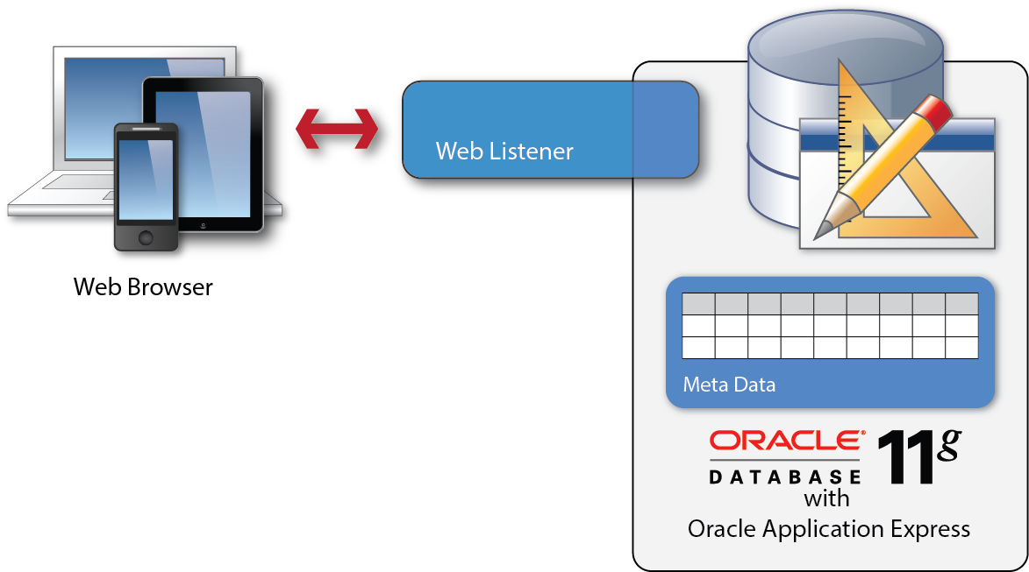
Oracle Application Express Architectural Overview
Simple 2-Tier Architecture
Pages dynamically rendered using database metadata
No code generation or file based compilation
Runs everywhere Oracle Database runs
Notes:
Simple architecture where browser goes through web listener to database – Web listener only used to pipe requests and send responses; no business logic
Each page request or submission dynamically reads metadata for the page, performs the necessary query or processing and returns the results.
As soon as you update the metadata can run immediately as no need to perform any code generation or file compilation

Slide 9
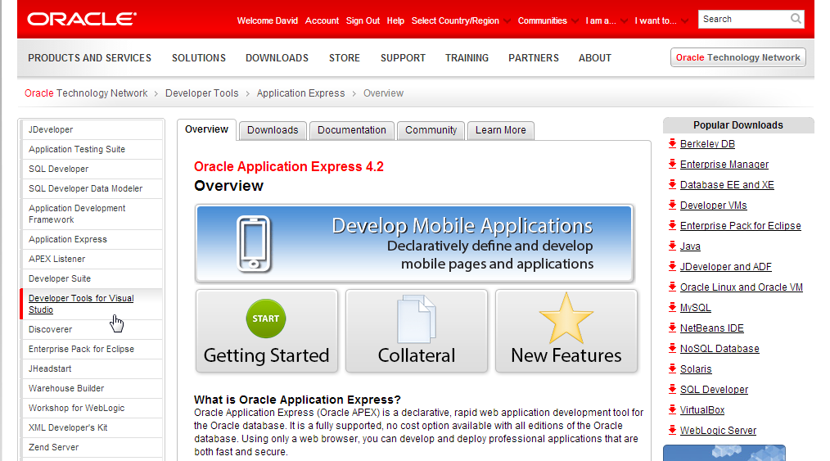
Oracle Application Express – Collateral
Oracle Technology Network → http://otn.oracle.com/apex
Notes:
APEX OTN Site is rigorously maintained and has an extensive array of information
Increasing number of Case Studies and other general information like Getting Started page
Collateral includes technical information, white papers, videos, and presentations
Deployment has details on installation, upgrades, deploying applications, UI, security and performance
Download Tab has the latest APEX version, Known Issues, etc
Community Tab lists consulting companies, commercial applications, public websites, hosting companies and community articles

Slide 10
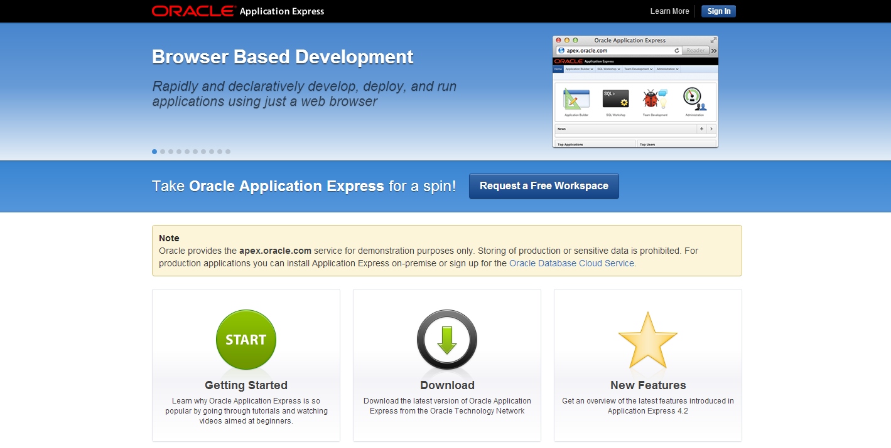
Oracle Application Express – Hosted Service
Free for “Development-Only” → http://apex.oracle.com/
Notes:
Apex.oracle.com is a free “Development Only” service.
Service has been running for over 10 years allowing developers to “kick the tires” with the latest version of APEX
Over 15,000 workspaces and > 6 million page views / week
Sign-up for an account to be able to start playing with APEX in minutes

Slide 11
Agenda
Oracle Application Express Overview
New Features in 4.2
Beyond Oracle APEX 4.2…
Q&A

Slide 12

Mobile Web-Based Applications
Uses the same Application Builder and declarative framework as for Desktop applications
Applications can support multiple user interfaces, both Desktop and Smartphone
Mobile pages use jQuery Mobile through jQuery Mobile based themes and templates
Includes HTML5 regions, item types, and charting engine
Notes:
The Application Builder is enhanced to support the declarative building of mobile applications. Among the numerous changes made are: Updated Create Application wizard to support generation of applications for Desktop or Mobile; Updated Create Page and Region wizards, to expose Components applicable to Mobile applications
By incorporating jQuery Mobile application wills render correctly on all mobile devices, old and new. Applications will run on iOS, Android, Blackberry, Windows Mobile etc.
For older devices that don’t fully support HTML5 equivalent components will be rendered so that users can still maintain data.
Updating charting engine allows defining HTML5 charts for mobile applications
Text fields can now have sub-types of Email, Phone and URL which will bring up appropriate keyboards on HTML5 compliant devices

Slide 13
Multiple User Interfaces
Applications can be associated with multiple user interfaces
Each user interface is associated with one theme
Each Page supports only one user interface
Applications can include desktop and mobile specific pages
User Interface defines device specific login URLs, home page URLs and device auto detection
Page 0 replaced by Global Page(s)

Slide 14
Mobile Themes and Templates
Themes & HTML Templates to support the development of Mobile applications – THEME 50
Default Mobile Page and Popup Transition Types
Declarative support to specify JavaScript & CSS files
Support Content Delivery Networks for jQuery files
New #PAGE_STATIC_ID# substitution string added to page templates
Notes:
Declarative Support to Specify JavaScript & CSS files: Add new application, page and page template attribute "JavaScript file URL(s)" to support declarative definition of JavaScript files which should be loaded for an application, page or page template. Add new page and page template attributes "CSS file URL(s)" and "Inline CSS" to support declarative definition of CSS files and inline CSS which should be loaded for a page.
Default Mobile Page & Popup Transition Type: Default mobile page and popup transition type (slide, slideup, flip, etc.) specified on theme level. Page level transition override - should contain an entry "Use Theme Default". Such attributes should only be visible when it's a mobile page template.
CSS Classes Attribute: A new attribute "CSS Classes" should be added to regions, buttons, page items and classic report columns to allow easier styling of this components. Region and button templates should support the new template placeholders #REGION_CSS_CLASSES# and #BUTTON_CSS_CLASSES#

Slide 15
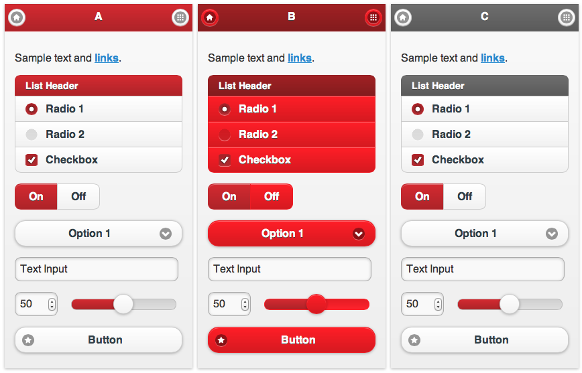
Mobile Themes and Templates
Easy to create custom Mobile theme using jQuery Theme Roller

Slide 16
Responsive Design
“Approach to web design in which a designer intends to provide an optimal viewing experience – easy reading and navigation with a minimum of resizing, panning, and scrolling – across a wide range of devices (from desktop computer monitors to mobile phones).”
… Wikipedia

Slide 17

Responsive Design
Fully Responsive Theme included (Theme 25)
Uses custom flexible grid up to 2560px wide
CSS3 Media Queries
Mobile, Tablet, Desktop support
Icon Buttons
Retina Display Compatible

Slide 18
Responsive Design
Modernizr
Detects HTML5 and CSS3 features in the user’s browser
SCSS Based
Extension of CSS3, adding nested rules, variables, mixins, selector inheritance and more. Gets translated to well-formatted, standard CSS
Respond.js for Responsive Web Design support in older IE
Sprite based graphics, icons

Slide 19
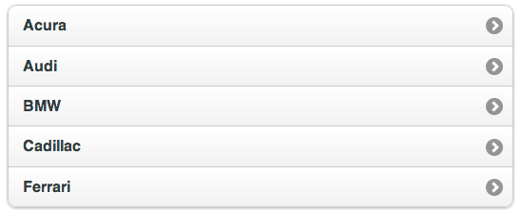
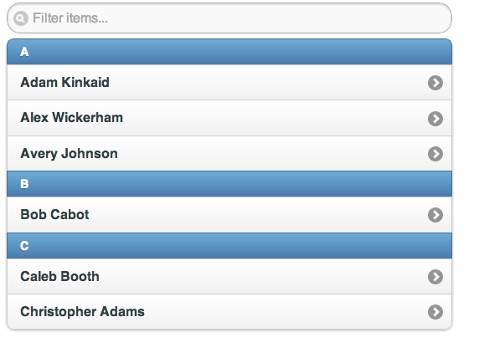
List View Region Type
Un-ordered list with data-role="listview"
Used for data display, navigation, list view and form pages
Full width by default with inset option
Automatic dividers
Declarative search filter
Client- and server-side search options
Simple list
Divided, filterable list
Notes:
data-role="listview“: A list view is coded as a simple unordered list containing linked list items with a data-role="listview" attribute. jQuery Mobile will apply all the necessary styles to transform the list into a mobile-friendly list view with right arrow indicator that fills the full width of the browser window. When you tap on the list item, the framework will trigger a click on the first link inside the list item, issue an AJAX request for the URL in the link, create the new page in the DOM, then kick off a page transition.

Slide 20
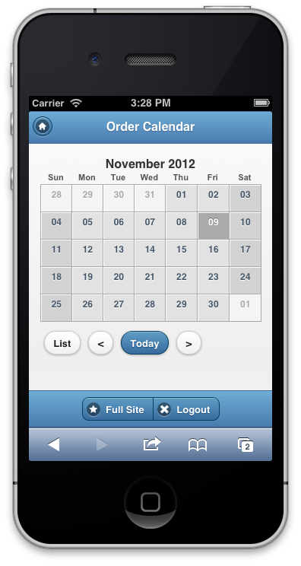
Mobile Calendars
Mobile-friendly calendar templates
New list-view for date entries
Monthly view shows date entries below calendar on mobile devices
Notes:
Creation of Mobile-friendly Calendar Templates: added support swipe / zoom / landscape view feature
New Calendar View Options: Adding a list view/agenda view as an additional option with existing monthly/weekly/daily calendars

Slide 21

Dynamic Action Enhancements
Expose jQuery Mobile events through Dynamic Actions e.g. swipe, touch, tap/hold, orientation
Provide ‘Custom’ event support
Declarative support for buttons to be the ‘Affected Element’
AJAX based Dynamic Actions to work asynchronously
Chart ‘Refresh’ Dynamic Actions support
Notes:
Expose jQuery Mobile events through Dynamic Actions: The jQuery Mobile framework exposes a number of events that provide useful hooks for developers of mobile applications. This feature extends the events exposed in the dynamic action framework, to incorporate these jQuery Mobile events. These events would only be exposed when the application context is appropriate i.e. Is a mobile application.
Provide ‘Custom’ event support: to allow for the definition of any custom events. This allows greater flexibility for advanced developers to attach dynamic actions based on events that we do not provide as out of the box events. For example to respond to events from other JS frameworks, or to respond to custom events triggered by the developer on the page. This is an additional option in the When > Event saying 'Custom', then an additional field displays allowing freetext specification of any event.
For mobile, we will not be exposing all jQuery Mobile events declaratively from the framework, as there are just too many. We will only expose what we deem as the highest value to the developer. Therefore, this custom event attribute will provide a way for developers to very easily hook in dynamic actions to any jQuery Mobile event we don't expose declaratively.
Declarative support for buttons to be ‘Affected Element’: Allow selection of buttons within the 'Action > Affected Elements' in dynamic actions. This would possibly only be relevant for a subset of actions (Show, Hide, Disable, Enable) and not others (Set Value, Refresh, etc).
Must be fully declarative, where the user can just select the button from a list, pick the action and they're done. Could be especially useful for situations where you want to say disable a button after it's been clicked, to try and prevent users from clicking a button multiple times in haste.
AJAX based Dynamic Actions to work asynchronously: Change certain server-side actions from firing synchronously to asynchronously. Additionally provide the developers with options on how subsequent actions are fired (queued or executed immediately via the 'Wait for Result' attribute).
Chart ‘Refresh’ Dynamic Action support

Slide 22
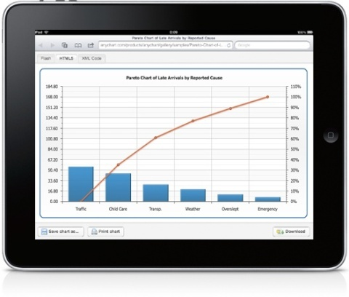
HTML5 Charts
HTML5 charts - AnyChart version 6
2 Chart Rendering options
Flash Preferred
HTML5
Conditional Display of Chart Series
HTML Chart region plug-in*
Notes:
With APEX 4.2 we have integrated AnyChart 6 charts, which contain a HTML5 (SVG based) version of their components. The aim was to make the HTML5 version a complete substitution for the Flash version as well as to make the switch to HTML5 as easy as possible for customers. A couple of the key features of this offering are:
HTML5 charts are configured exactly the same way as Flash ones - in XML.
The names of API methods are the same.
The HTML5 version is designed to work in all up-to-date versions of popular desktop browsers, such as Chrome, Safari, Firefox, Internet Explorer, and Opera.
It is also compatible with popular browsers for the mobile platforms Android (2.2+) and iOS (iPhone, iPad, iPod Touch).
2 Chart Rendering Options: The user will be presented with the option of creating either a ‘Flash Preferred’ or ‘HTML5’ chart. When ‘Flash Preferred’ is selected, the generated chart will render as a Flash chart where Flash is detected. However, it was fall back to rendering as a HTML5 chart where Flash is not found. The ‘HTML5’ chart will generate a HTML5 chart. Through the Edit Chart wizard the user has the ability to switch between the two rendering type, if they wish.
Conditional Display of Chart Series: as with many of the other APEX components, users will now have the ability to define conditions on their chart series queries where previously they were required to remove a series query if it was to be removed from a chart.
HTML Chart region plug-in: with the integration of HTML5 charts, we have phased out the original ‘HTML Chart’ wizard option. So users will need to install a new HTML Chart region type plug-in, in order to create those charts. Applications with existing HTML charts will still be able to edit their charts, and will also have the option to upgrade them to HTML5 charts. The upgrade option is also provided for any existing SVG charts and also older Flash charts.

Slide 23

HTML5 Item Types
Incorporated HTML 5 attributes:
HTML5 placeholder attribute
HTML5 text field sub-types EMAIL, TEL and URL
HTML5 “required” attribute
Display Orientation attribute
New Items Types:
Slider
Date Picker (HTML 5)
Yes/No (Flip Toggle Switch)
Notes:
As part of our support for declarative mobile application development, we have integrated a number of new HTML5 item type, with more to come! This list is not exhaustive, just a few examples of what you can expect to see supported out of the box with APEX 4.2:
Slider: Support new item type "Slider" which renders as HTML5 range input type which is switched to a nice slider by jQuery Mobile and as jQueryUI slider in non Mobile Environments.
Date Picker (HTML5): Add new item type "Date Picker (HTML5)" which is using the new HTML5 input types DATE and DATETIME-LOCAL which are supported by modern smartphone and tablet browsers to pick a date with native operating system controls.
Yes/No (Flip Toggle Switch): Support new item type "Yes/No" selection which renders as Flip Toggle Switch in jQuery Mobile User Interfaces and as Select List in non Mobile Environments.
HTML5 attributes:
HTML5 placeholder attribute :Using native HTML5 support, the placeholder attribute shows text in a field until the field is focused upon, then hides the text e.g. In a “First Name” field, the placeholder attribute could be set to “Enter your First Name….”. The following item types should support the HTML5 placeholder attribute. Color Picker Date Picker Date Picker (Classic) List Manager Number Field Password Popup LOV Text Field Text Field with Calculator Popup Text Field with autocomplete Textarea The new attribute should also be exposed to plug-in developers.
HTML5 required attribute: Add the HTML5 "required" attribute to the generated INPUT/SELECT/TEXTAREA/... HTML controls if the "Required" = Yes for a page item. This allows advanced CSS3 styling of required page items. See http://www.the-art-of-web.com/html/html5-form-validation/
HTML5 types EMAIL, TEL and URL for textfield item type: Text Field should have new 'Subtype' to support HTML5 input types (email, phone, url). This is useful for touch based devices which show an optimized keyboard for the type.
Display Orientation attribute: The item types Checkbox and Radio Group should have a new attribute "Display Orientation" with the values
Vertical
Horizontal
The default will be Vertical. This attribute will only be used for jQuery Mobile user interfaces.
Additional attributes to come in 4.2…..
New attribute for 'Case Restriction' (Upper, Lower, InitCap). Protects fields (as was available in Forms). LOV should be displayed inline / on current page, not in a popup. Should be optimised for mobile output. Colour picker should use HTML5 type="color" (only on mobile). Emit cleaner HTML code for existing item types. Including surrounding <div> around item types. New attribute Autocomplete on text field. Investigate if Rich Text Editor works / supported on iPad. Resizeable text areas, should fallback to native browser resizing where possible. Also look at other enhancements here, automatic resizing to available space, persisting previous size.

Slide 24

Packaged Applications
Suite of business “Productivity” applications installable with only a few clicks
Production-ready applications include Project Management, Survey Builder, Checklists, etc.
Support for Third-party applications, sharing same infrastructure and user pool
Includes “Sample” applications to demonstrate key functionality, such as Dynamic Actions, Reports, Charts, etc.
Notes:
Oracle Application Express includes a number of packaged business applications, which are available free of charge, can be used as production applications and will be supported by Oracle. These applications enable customers to improve their business processes and secondly, a set of sample feature applications have been designed to help customers quickly understand specific capabilities of Application Express.
The packaged applications are locked and can't be modified by customers. Customers who wish to modify a packaged applications or simply review its implementation will be able to unlock the application. Once unlocked, the application is no longer supported by Oracle and can no longer be updated. Customers can always return to a supported version by removing the unlocked copy and re-installing the locked version.

Slide 25
Packaged Applications
Productivity Apps
Project Tracker
Survey Builder
Data Reporter
Checklist Manager
Customer Tracker
Group Calendar
Bug Tracker
Asset Manager
Application Archive
Sample Code
Calendars
Charts
Data Loading
Dynamic Actions
Interactive Reports
Master-Detail Forms
Tabular Forms
Trees
Sample Database Application
Sample Websheets

Slide 26

RESTful Web Services
Interaction with data sources through use of Uniform Resource Identifiers (URIs)
Standard method of accessing data in the Oracle Cloud
Ability to create services which implement any SQL statement or PL/SQL procedure
Data returned in JSON or CSV format, or additionally through PL/SQL
Notes:
RESTful Web Services in APEX 4.2 provides stateless access to data and logic, through the use of SQL and PL/SQL using the Oracle APEX Listener 2.0 or later.
APEX can also consume both RESTful and SOAP based Web Services

Slide 27


Oracle Application Express Other 4.2 Functional & Security Improvements

Slide 28
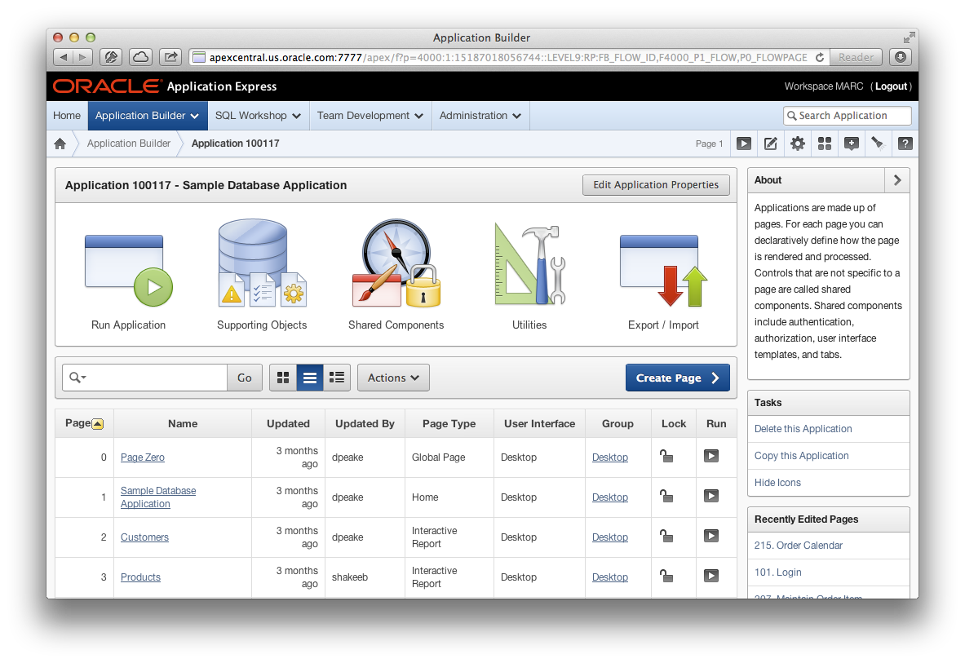
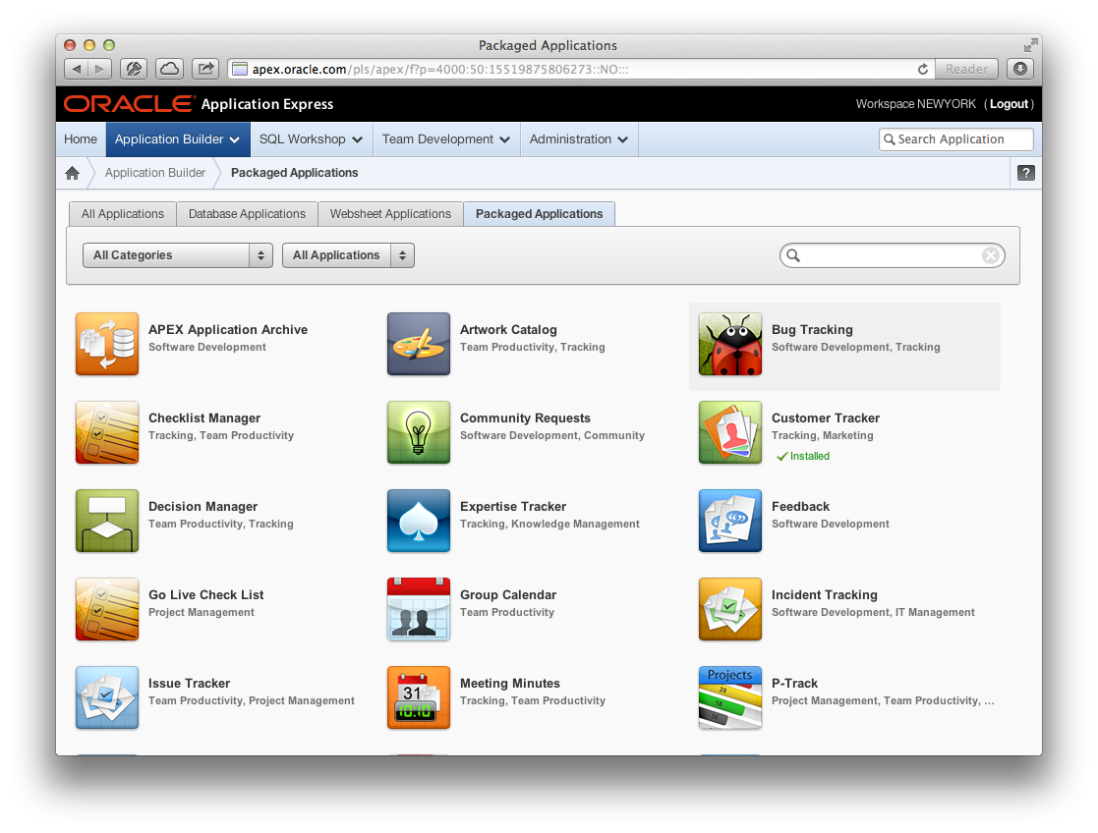
Enhanced Application Builder User Interface

Slide 29
Grid Layout
Declarative way to lay out regions and items on a page
Possible to do complex layouts without manual CSS overrides
Compatible with popular grid frameworks such as twitter bootstrap, 960 gs, etc.

Slide 30
Grid Layout
Three types of grid layout available:
HTML Table - Uses HTML tables to position regions, items and buttons.
Fixed Number of Columns - Used for grids which divide the screen into a fixed number of grid columns.
Variable Number of Columns - Used for grids which can display up to "n" number of grid columns depending on how the regions, page items and buttons are positioned.

Slide 31

Plug-In Enhancements
Increased Number of Custom Attributes to 25
New Standard Region Type Plug-in Settings:
‘Fetched Rows’
‘No Data Found Message’
New APIs in apex_plugin_util to better support custom plug-in attributes of type "Region Column Name "
Add support for media queries and IE conditions to apex_css and apex_javascript APIs
Notes:
Increased Number of Custom Attributes to 25: The number of custom attributes (scope=component) for region type plug-ins is increased from 15 to 25. This is required for our new List View region type plug-in.
New APIs in apex_plugin_util to better support custom plug-in attributes of type Region Column Name: Add new APIs to apex_plugin_util to better support custom plug-in attributes of type "Region Column Name". Instead of passing a column no (eg. p_search_column_no) the APIs should now also support passing a column name (eg. p_search_column_name).
New Standard Region Type Plug-in Settings:
‘Fetched Rows’ => Add the attributes "Number of Fetched Rows" and "Number of Fetched Rows (item)" as standard attribute which can be exposed for region type plug-ins. This can be used by region type plug-in to determine how many rows should be fetched/displayed for pagination of the region source data. The new attribute is exposed as p_region.fetched_rows in the p_record structure which is passed to a plugin.
‘No Data Found Message’ => Add the attributes "No Data Found Message" as standard attribute which can be exposed for region type plug-ins. This can be used by region type plug-in to determine what should be displayed if nothing was found. The new attribute is exposed as p_region.no_data_found_message in the p_record structure which is passed to a plugin.
Add support for media queries and IE conditions to apex_css and apex_javascript APIs : The APIs apex_css.add_file have two new parameters
p_media_query to specify a value for the meta="xxx" attribute of the <link> tag
p_ie_condition to include an Internet Explorer condition for the link tag in the format <!-- [if xxx]><link><!--[endif]>
The APIs apex_javascript.add_library has one new parameter
p_ie_condition to include an Internet Explorer condition for the script tag in the format <!-- [if xxx]><script src="xxx"><!--[endif]>
Media-specific style sheets are supported by several user agents. The most commonly used feature is to distinguish between ‘screen’ and ‘print’.

Slide 32

Data Upload Enhancements
Allow up to 3 columns in Look-up Definition
Expand transformation rules to include PL/SQL
Provide aliases for column names

Slide 33
Partitioning of APEX Runtime Tables
Supported method to partition APEX runtime tables (session data, activity logs and indexes)
Useful in very high-load Oracle Real Application Clusters (RAC) environments
Improves Node-affinity
Instance 2
Instance 3
Instance 1

Slide 34
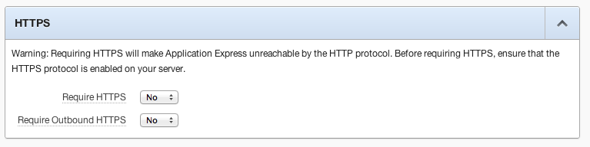
Security: Outbound HTTPS
Require all outbound requests to be over HTTPS.
Region of type URL, Web Services

Slide 35
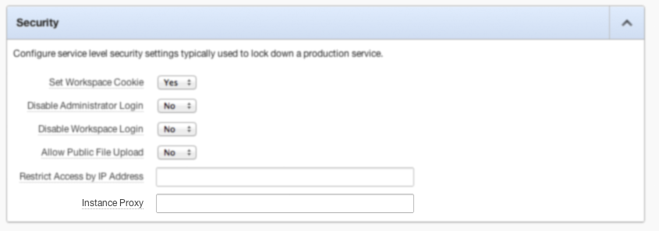
Security: Instance-wide Proxy
Require all outbound HTTP(s) traffic to use an instance-wide proxy

Slide 36
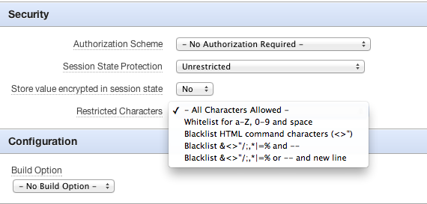
Security: Restricted Characters
Declarative control over which characters can be entered into session state
Input validation

Slide 37
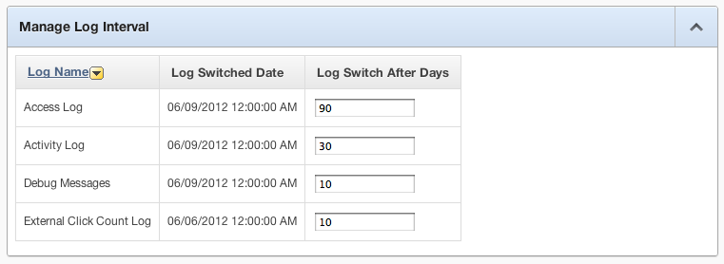
Security: Log Switch (Data Retention)
Retention of all logs is now variable (Not fixed at 14 days)
Greater log switch interval can possibly degrade performance

Slide 38
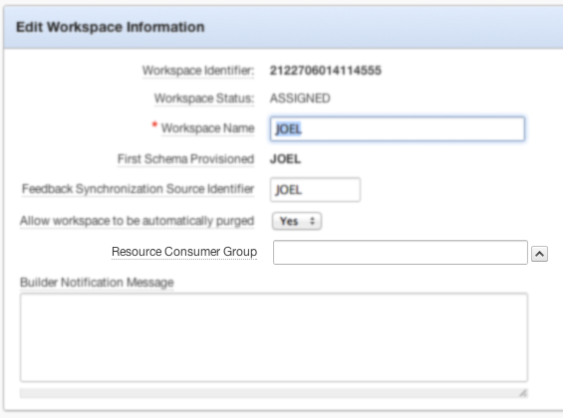

Resource Manager Consumer Group
All requests from a workspace can be confined to a resource consumer group

Slide 39
V$SESSION changes
Module: Parsing DB User/APEX:APP Application ID:Page ID
Client Info: Authenticated Username:Workspace ID
Client ID: Authenticated Username:Session ID

Slide 40
Other New Features in APEX 4.2
Item limit per page raised from 100 to 200
SQL Workshop Date Format
Named Branches
Read-only attribute for Pages and Regions
Publish Translations from command-line
Interactive Report and Websheet enhancements
Instance Administration improvements
New CKEditor, jQuery and AnyGantt charts versions
Notes:
Interactive Report Enhancements: among the various enhancements, one particular one to note is the new API returning an IRR's current SQL query to help advanced developers add functionality that is dependent on the current information displayed in an interactive report region.
APEX JavaScript Library cleanup: In development of a cut-down JavaScript library for 4.2, we have moved many old JavaScript functions out to a legacy JavaScript file. This is currently 23KB, and ever increasing as we continue work on the library. This feature will allow the customer to control whether they want to include these legacy functions in their applications, and also how we deal with migration and defaulting. "Include Legacy JavaScript" option in Application Properties - If set to "Yes", we will include the legacy JS functions in our combined JS deployment file for that application. If set to "No", we will include a different combined JS deployment file that does not include these functions. Existing applications will default to "Yes" for backwards compatibility, in case the customer may have used some of these functions in their own applications. New applications will default to "No". Customers will then be able to configure this in their applications, such that if they are happy that existing applications do not contain any references to these functions, they can switch this to "No". Alternatively of course, if a customer wants to build a new application, and perhaps still include the legacy functions, they can set this to "Yes".
CKEditor 3.6.2 - Many bugs including Translation issues are fixed and IOS 5.0 support provided in the new version.
jQuery –the most recent version of jQuery (v 1.7.1) and jQuery UI (v 1.8.18)
AnyGantt 4.2.0

Slide 41
Agenda
Oracle Application Express Overview
New Features in 4.2
Beyond Oracle APEX 4.2…
Q&A

Slide 42

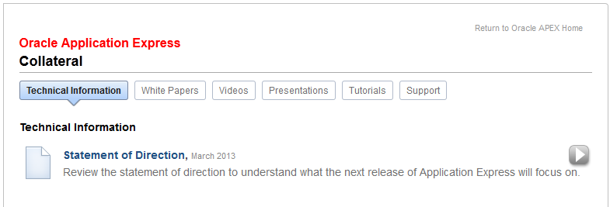
Statement of Direction
APEX OTN Site (http://otn.oracle.com/apex)
Notes:
Last Updated October 2013

Slide 43
Oracle Application Express 5.0
Statement of Direction
Modal Dialogs | New Multi-Row Edit Region
Drag and Drop Layout Editor | Master / Detail / Detail
HTML5 Capabilities | Multiple Interactive Reports
Tablet User Interface | Packaged Applications
Web Services Support | Application Builder Security
Enhanced PDF Printing | Websheets
Notes:
Last Updated October 2013

Slide 44
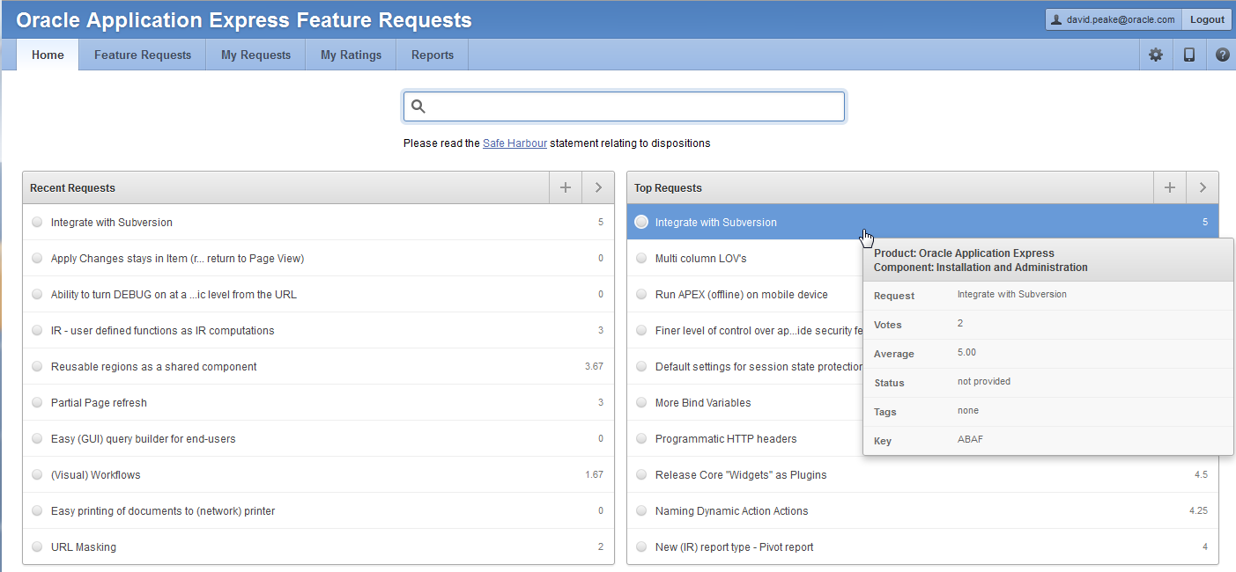

Oracle Application Express Feature Requests
http://apex.oracle.com/vote
Notes:
Feature Requests allows you to enter new requests and vote on existing requests.
There is also an APEX Feature Advisory Board, made up of a number of APEX experts, to help advise the APEX Development Team on the importance of requests.

Slide 45


Slide 46



Slide 48
声明：
所有的版权属于原有公司，文件均来自公开渠道
此文件仅供学习使用，任何人不得进行以此为商业目的的行为
如有疑问，请立即删除
学习世界五百强和咨询公司PPT课程请访问如下网站搜索：“司马懿”
百度传课：司马懿PPT学校
https://www.chuanke.com
网易学堂：司马懿PPT学校
https://study.163.com
知乎： 司马懿PPT学校
https://www.zhiu.com

